Slide 1
Empowering independence with ai-enhanced applications

Slide 2
Problem statement: mobile application solution for healthcare,payer,and insurance

Slide 3
Team name : tech army team members: e.g.Pradeep m.s.saisankeet g.suriayaa v.koucikan b.prasanth

Slide 4
Segmentations in healthcare to solve : in our application, we are Segmented as a basis for allocating services, products, and information to individuals is not commonplace in health care . In our Segmentation, procedures often use therapeutic domain or stage of development of a disease as criteria for differentiation (usually exclusively bio-medically oriented). The consequence of this approach is that depending on disease type, individuals, in addition to relevant medical treatment will receive the same additional service and support. At best, there may be some differentiation depending on the stage of the disease. Studies that include psychological factors are rare . It should be mentioned that all these studies are empirically driven. A promising model for segmentation in health care is the Bloem-Stalpers model

Slide 5
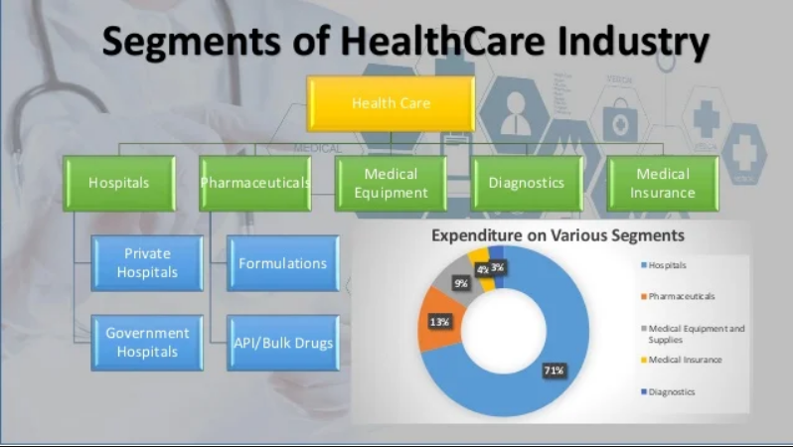

Slide 6
Methods to solve healthcare problems using applications: our healthcare applications can help you to stay ahead of the curve and lend a hand in placing you among the top technological healthcare providers. We have tried to list some of the most addressed problems the new advanced healthcare system can solve using the technology for a better and healthier world.healthcare Apllications can be used to support consumers in a variety of health tasks to manage chronic diseases, support lifestyle changes and in self-diagnosis. For clinicians, they can improve access to patient information and clinical decision support tools at the point-of-care .Other benefits of healthcare apps include improved patient engagement, minimized risks of misdiagnosis, immediate access to care, hassle-free payments, improved prescription alerts, and enhanced data management. Health care apps offer features that let patients and others monitor their health. These apps often let you measure and record things like your weight, blood sugar level, heartbeat, blood pressure and cholesterol. This can enable a patient to take immediate action if levels increase or decrease. Patients can now immediately connect with their doctors and their practice through their phones to schedule appointments, receive appointment reminders, and even contact them if there's an emergency. Medication apps for an android or iPhone allow patients to track their medications and set up reminders so they don't miss a dose.

Slide 7
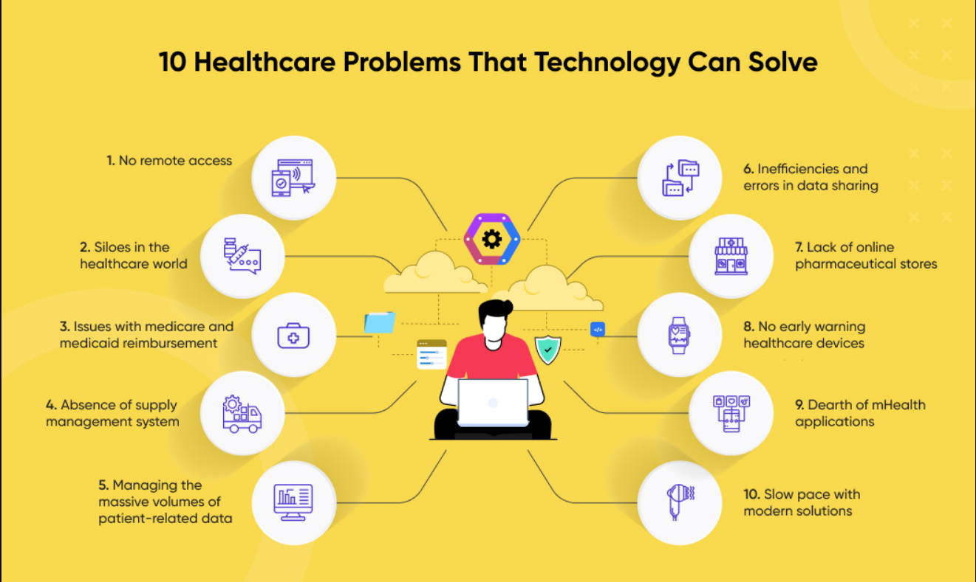

Slide 8
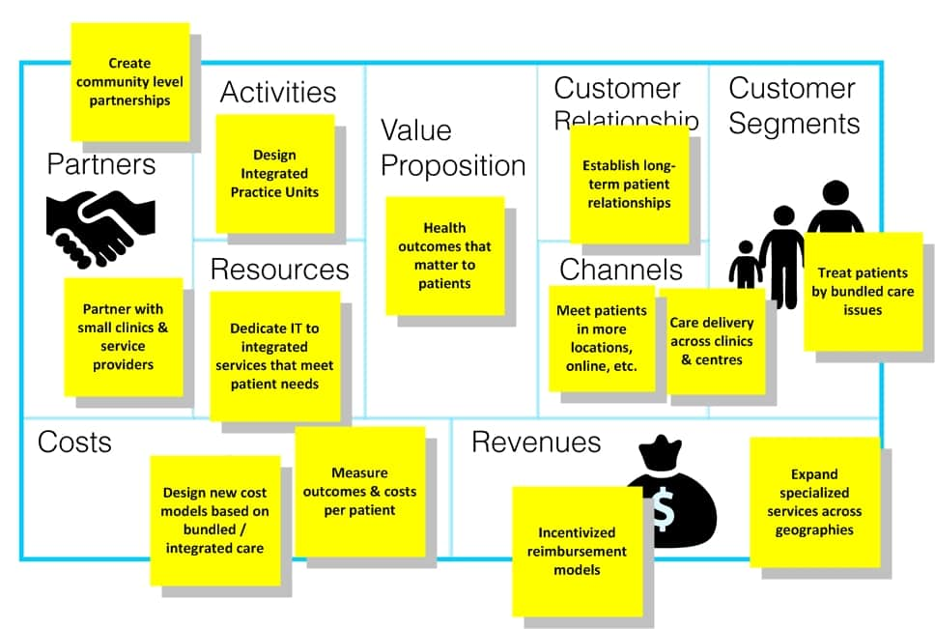
Bmc model for healthcare applications:

Slide 9
Team member roles : web page design and team lead v.koucikan. Content creation for web design: e.g.Pradeep. M.s.sai sankeet website creation: g.suriyaa. B.prasanth.

Slide 10
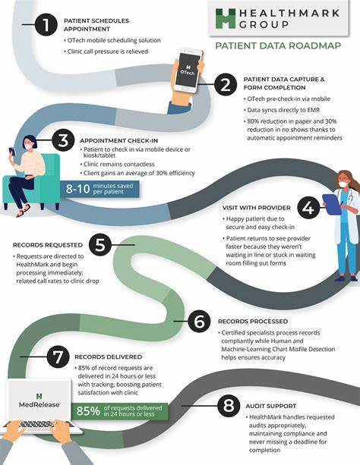

Slide 11
Our plan of action to publish healthcare applications : Improved patient engagement – patients can access and monitor their medical records/prescription details; Minimized risk of misdiagnosis – applications serve as unified storage of patient data; Automated billing and payments – patients can make instant payments securely with a few clicks; Improved prescription alerts – electronic reminders are sent directly to patients’ smartphones; Better interoperability of health data – digitally stored medical data can be easily accessed by other healthcare systems.

